Slide 1
FINAL PROJECT ANIMAL KINGDOM
Simulator

Slide 2
Name : Leela Shanti A/P Sundrsegaran
Student ID: MC220919180
Course : 2023/01 ITWM5113
Course Title : Software Design and Development
Assignment : Final Project
Instructor : DR. Hadi Naghavipour
Github link : https://github.com/LS1719/Animal-Kingdom-Simulator.git

Slide 3
INTRODUCTION
This final project give me practice with defining classes. I am required to write a set of classes that define the behavior of certain animals. In this final project I was given a program that runs a simulation of a world with many animals wandering around in it. Different kinds of animals will behave in different ways and I’m defining those differences.
Every object in this world is a "critter", where Critter is the super class with default behavior defined. I was required to write five classes, each representing a different type of Animal: Bear, Tiger, WhiteTiger, Giant and NinjaCat. All of the classes I write should be sub classes of Critter. On each round of the simulation, each critter is asked for 3 pieces of information:
How should it act?
What color is it?
What string represents that critter?

Slide 4
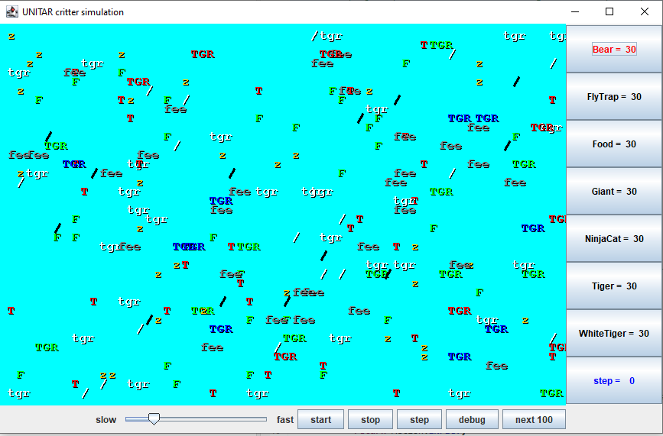
Critters
The 3 pieces of information are provided by 3 methods present in each Critter class. You will be responsible for overriding these methods and programming their appropriate behavior: A simulation world with animal objects with behavior:
getMove movement
toString letter to display
getColor color to display
You must implement:
Bear
Giant
Tiger
White Tiger
Ninjacat

Slide 5
A Critter subclass
public class name extends Critter {
...
}
extends Critter tells the simulator your class is a critter
an example of inheritance
Write some/all 5 methods to give your animals behavior.

Slide 6
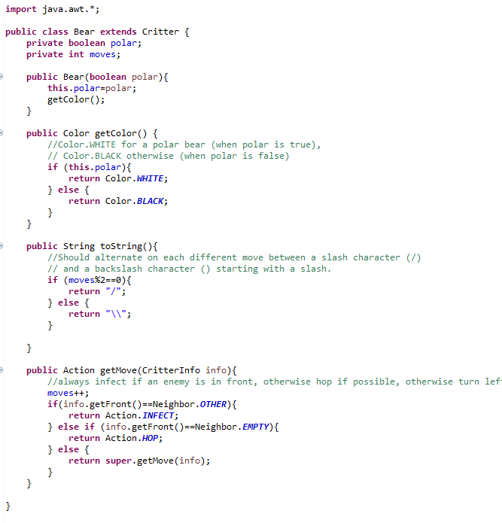
Bear

Slide 7
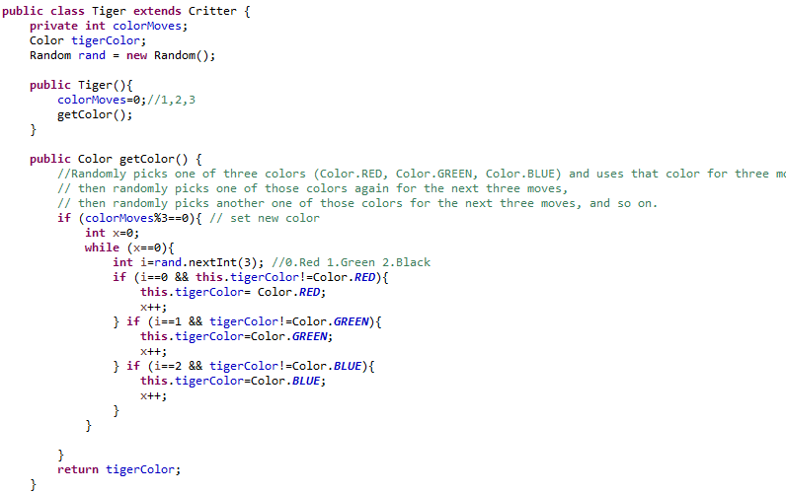
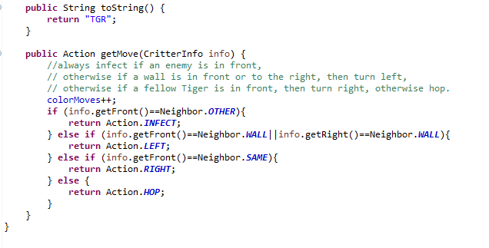
Tiger

Slide 8
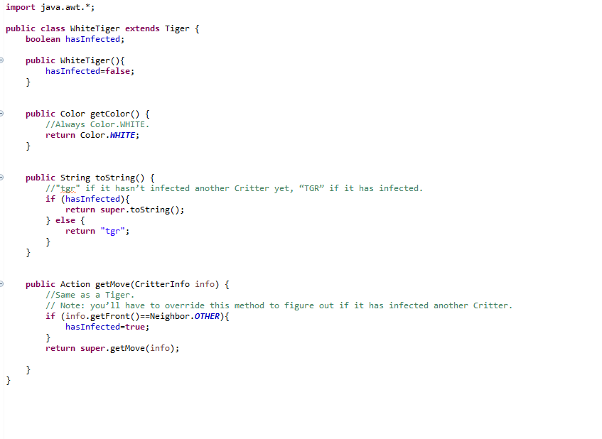
White Tiger

Slide 9
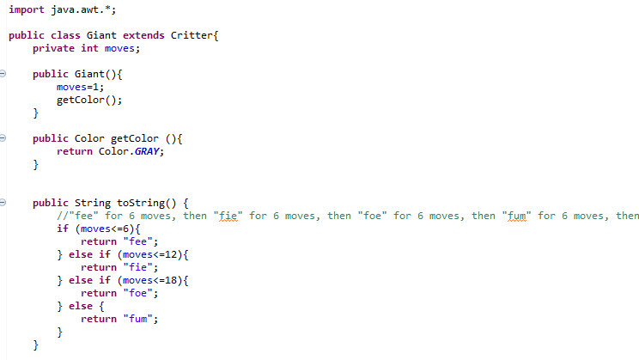
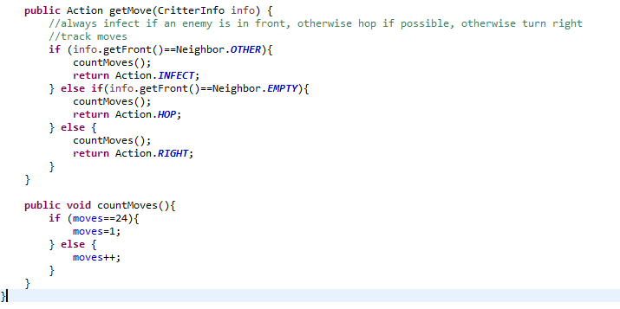
Giant

Slide 10
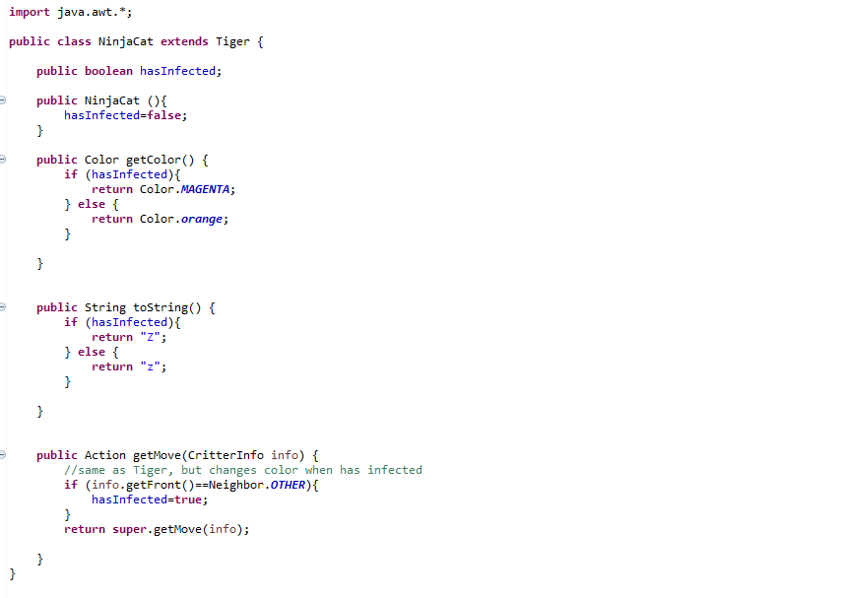
NinjaCat

Slide 11
How the simulator works
When you press “Start", the simulator enters a loop:
move each animal once (getMove), in random order
Action.HOP Move forward one square in its current direction
Action.LEFT Turn left (rotate 90 degrees counter-clockwise)
Action.RIGHT Turn right (rotate 90 degrees clockwise)
Action.INFECT Infect the critter in front of you
Key concept: The simulator is in control, NOT your animal.

Slide 12
Simulator exercise
Write a critter class
Method | Behavior
infect | INFECT if an enemy is in front of them
getColor() | For getColor you should return whatever color you want the simulator to use when drawing your critter
toString() | return whatever text you want the simulator to use when displaying your critter (normally a single character)
getMove() | return only 4 different things: Action.HOP Move forward one square in its current direction Action.LEFT Turn left (rotate 90 degrees counter-clockwise) Action.RIGHT Turn right (rotate 90 degrees clockwise) Action.INFECT Infect the critter in front of you

Slide 13
Conclusion
Through the use of Java, this project will promote Object Oriented Programming (OOP). By using Java Classes and Methods and OOP approaches to build the Animal Kingdom Game, the project seeks to advance programming abilities.
The Animal Kingdom is a large and complex set of living beings that are incredibly significant in many academic fields and are essential to ecosystems. Java models of the animal world that take advantage of concepts from object-oriented programming such as classes, objects, inheritance, polymorphism, and encapsulation provide a robust framework for defining the diverse characteristics and behaviours of animals.

